Slide 1

Computer Science & Technology
PROJECT PHASE 1
FINAL REVIEW
Team No: 2
Team Members: Priyanka Sharma (ENG21CT0030)
Sukriti Srinivasa (ENG21CT0039)
Sunidhi KS (ENG21CT0040)
Vidushi Modi (ENG21CT0048)
Guide: Dr. Santosh Kumar J (Associate Professor)
Department: Computer Science & Technology
University: Dayananda Sagar University

Slide 2
AgriLink
COMPUTER SCIENCE AND TECHNOLOGY
AgriLink
AI-Driven Solutions for Crop Marketplace and Disease Management: AgriLink
AgriLink assists farmers throughout the entire farming process—from detecting crop diseases using AI, enhancing their skills through a Learning Management System (LMS) and to help them list and sell their produce directly to retailers and consumers, removing middlemen for better profits.

Slide 3
AgriLink
COMPUTER SCIENCE AND TECHNOLOGY
Abstract
AgriLink is a comprehensive platform designed to help farmers at every stage of farming. It offers AI-driven crop disease detection, a Learning Management System (LMS) for continuous education, and for listing, negotiating, and transacting produce directly with buyers. By removing intermediaries, AgriLink ensures that farmers get the profits they deserve, while also enhancing their productivity and knowledge.

Slide 4
AgriLink
COMPUTER SCIENCE AND TECHNOLOGY
Introduction
Farming is not just about growing crops—today, it encompasses disease management, skill enhancement, and ensuring fair market access. Many farmers struggle with detecting crop diseases early, accessing modern farming techniques, and navigating the market without losing profits to middlemen. AgriLink addresses these challenges by providing an AI-powered solution for crop disease detection, an LMS for learning farming best practices, and a market platform that helps farmers sell directly to retailers and consumers, ensuring better financial returns.

Slide 5
AgriLink
Literature Survey
Research Paper | Gap | Need
Mobile-Based Agricultural Apps for Farmers’ Welfare in India (Manobharathi K, 2021) | Low adoption of ICT tools due to limited digital literacy and reliance on middlemen. | User-friendly, real-time mobile apps providing market, weather, and expert advisory services.
A Study of E-Marketing Apps for Agricultural Products (Kajal V. Khandagale, 2022) | Inefficiency, price manipulation, and reliance on middlemen in agricultural markets. | Digital platforms that offer transparency, reduce marketing costs, and provide real-time data.
Android App for Farmers to Sell Their Crops (Vamsidhar Reddy et al., 2023) | Existing apps include intermediaries, reducing farmers' profits. | Direct platforms allowing farmers to sell crops without middlemen, with added features like soil and weather data.
Developing a Crop Disease Detection using Deep Learning (Rahul Papalkar, Abhishek Mane, 2023) | Limited real-time disease detection | Realtime crop monitoring system with solutions.

Slide 6
AgriLink
COMPUTER SCIENCE AND TECHNOLOGY
Research Gap
Key aspects:
Limited Adoption: Farmers are not widely adopting current digital platforms due to their complexity and reliance on intermediaries.
Lack of Personalized Support: Most apps fail to offer AI-driven recommendations that provide customized pricing and market insights based on real-time data.
Missing Voice Assistance: No existing apps fully integrate voice assistance for farmers with low digital literacy, limiting accessibility.
Our Solution:
AgriLink fills the gap by offering an AI-powered, voice-assisted platform that simplifies market access for farmers, provides personalized recommendations, and ensures ease of use through voice navigation.

Slide 7
AgriLink
COMPUTER SCIENCE AND TECHNOLOGY
Problem Statement
Farmers face multiple barriers in selling and growing their produce, including:
Middlemen driving up costs and reducing profits.
Limited access to wider markets, especially for small scale farmers.
Complex digital platforms that are not designed for users with low technical literacy.
Our solution tackles these challenges by providing a simple, localized app that streamlines the entire process from listing produce to final transactions, all while enhancing the learning experience for farmers.

Slide 8
AgriLink
COMPUTER SCIENCE AND TECHNOLOGY
Objectives & Methodology
Disease Detection:
AgriLink will help farmers detect crop diseases early by using AI to analyze images of crops and provide quick diagnoses and treatment recommendations, making disease management easier and more efficient.
Learning Management System (LMS):
The platform includes a built-in learning system where farmers can access tutorials, expert advice, and best practices on crop management, helping them improve their skills and knowledge.
Voice Assistance:
With voice assistance, farmers can navigate the app, get recommendations, and manage their farms through simple voice commands, making it accessible to those with limited technical skills.

Slide 9








AgriLink
COMPUTER SCIENCE AND TECHNOLOGY
RoadMap
1
2
3
4
5
6
RESEARH & REQUIREMENT GATHERING
USER FEEDBACK & ITERATION
DEPLOYMENT & FUTURE
WIREFRAMING
DEVELOPMENT
TESTING
Create wireframes for key screens (home, produce listing, transaction, AI recommendations, etc.).
Ensure mockups incorporate voice assistance and multilanguage support.
Share mockups to potential users (farmers, retailers).
Gather feedback and iterate on designs to ensure simplicity and functionality.
Set up backend and frontend architecture.
Implement AI-powered recommendation engine.
Integrate voice assistance (Google Speech API) and Firebase for data storage.
Conduct unit testing, integration testing, and user acceptance testing (UAT) for all modules.
Ensure compatibility with various devices and offline functionality in low connectivity areas
Host on AWS, ensure scalability and security measures are in place.
Pilot the app in a few regions and gather user feedback for improvements.
Expand LMS content, introduce financial tools, and scale AI recommendations.
Study farmers’ needs, market trends, and user personas.
Identify the core features and prioritize them based on user impact.

Slide 10
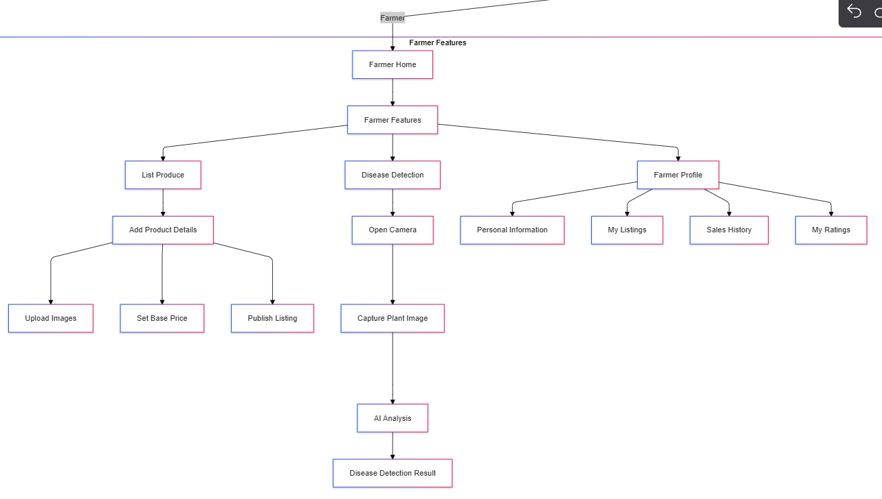
AgriLink
Flowchart

Slide 11
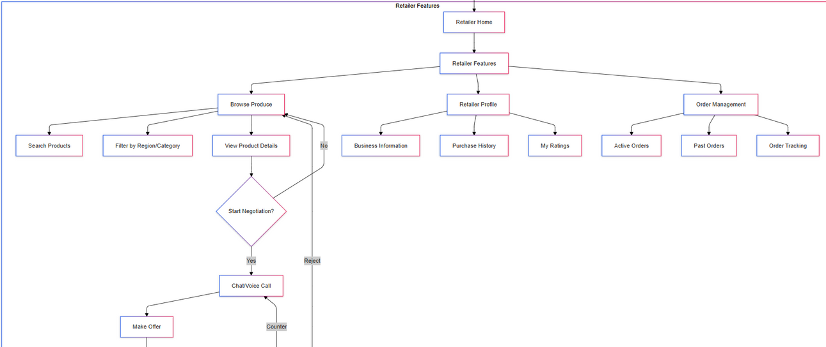
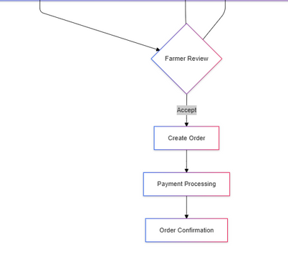
Flowchart
AgriLink

Slide 12
AgriLink
POC
Design A
Design B

Slide 13
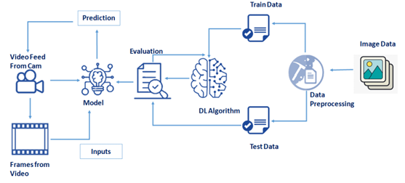
Architecture of Disease Detection

Slide 14
AgriLink
COMPUTER SCIENCE AND TECHNOLOGY
References
Farm Interview Audio
Existing apps
Field Visit Report

